Slide 1



AX/FINANCE & OPS
San Antonio, Texas
October 13-17, 2024

Slide 2
D365FO Security Customization Showdown : Code vs Configuration

Slide 3

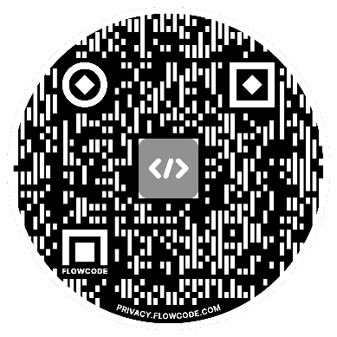
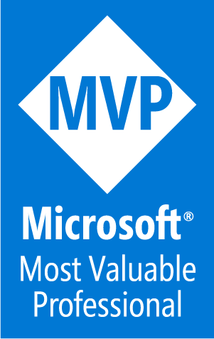

Alex Meyer
Principal Software Development Engineer
Delinea
Email: alex.meyer@delinea.com
Blog: http://d365foblog.com
Security Class: http://d365fosecurity.com
GitHub: https://github.com/ameyer505
LinkedIn | Microsoft MVP Profile
Background:
Awarded Microsoft MVP in Business Applications since 2019
Been working with AX since 2013
Been working with D365FO since 2016
Have spoken at Summit (US & Europe), Focus, and local chapters around AX/D365FO security and have done webinars around native controls in both versions

Slide 4

Alex Meyer
Principal Software Development Engineer
Delinea
Email: alex.meyer@delinea.com
Blog: http://d365foblog.com
Security Class: http://d365fosecurity.com
GitHub: https://github.com/ameyer505
LinkedIn | Microsoft MVP Profile
Background:
Awarded Microsoft MVP in Business Applications since 2019
Been working with AX since 2013
Been working with D365FO since 2016
Have spoken at Summit (US & Europe), Focus, and local chapters around AX/D365FO security and have done webinars around native controls in both versions

Slide 5


Nathan Clouse
Technical Architect
Armanino LLP
Email: nathan.clouse@armanino.com
Blog #1: https://www.atomicax.com
Blog #2: https://www.dynamics.fo
GitHub: https://github.com/NathanClouseAX
@NathanClouseAX on most platforms
Background:
Awarded Microsoft MVP in Business Applications since 2019
Been working with AX since 2009
Been working with D365FO since 2017
Have spoken at Summit, Focus, and local chapters around various AX/D365FO technical topics plus other groups events

Slide 6

Nathan Clouse
Technical Architect
Armanino LLP
Email: nathan.clouse@armanino.com
Blog #1: https://www.atomicax.com
Blog #2: https://www.dynamics.fo
GitHub: https://github.com/NathanClouseAX
@NathanClouseAX on most platforms
Background:
Awarded Microsoft MVP in Business Applications since 2019
Been working with AX since 2009
Been working with D365FO since 2017
Have spoken at Summit, Focus, and local chapters around various AX/D365FO technical topics plus other groups events

Slide 7
Agenda
D365FO Security Overview
Security Customization Options
Configuring Security via Configuration (User Interface)
Configuring Security via Code (AOT)
Demo
Questions

Slide 8
Security Model Overview

Slide 9
Role Based Security
Users are assigned to one or more roles
Pessimistic security model
Hierarchy based security model
Groups of securable objects are put within one security layer
Security layers built on top of each other
Two main categories:
Security Layers
Securable Objects

Slide 10
Security Layers
Roles
Broadest security layer
Represent a job function a user would perform
Account, Account Payable, etc
Made up of any number of sub-roles, duties, or privileges
Duties
Middle security layer
Represents a general task a user would perform
Approve customer invoices, maintain budget plan, etc
Made up of any number of privileges
Privileges
Most granular security layer, where object assignment occurs
Represents a very specific process a user would perform
Add a BOM Line, Edit Customer, etc

Slide 11
Securable Objects
Menu Items
Displays – linked to forms within D365FO, pages user goes to in UI
Outputs – reports users can export
Actions – actions users can perform (posting a PO/JE, cutting a check)
Tables
Refers to SQL tables, where data is actually stored
Data Entities
Combines multiple SQL tables to encapsulate a business concept (purchase orders, users, etc)
Allows for CRUD operations from external services
Does not require X++ knowledge to utilize / consume
Service Operations
Externally facing API endpoints that can be used by external services
Requires X++ knowledge to utilize / consume

Slide 12
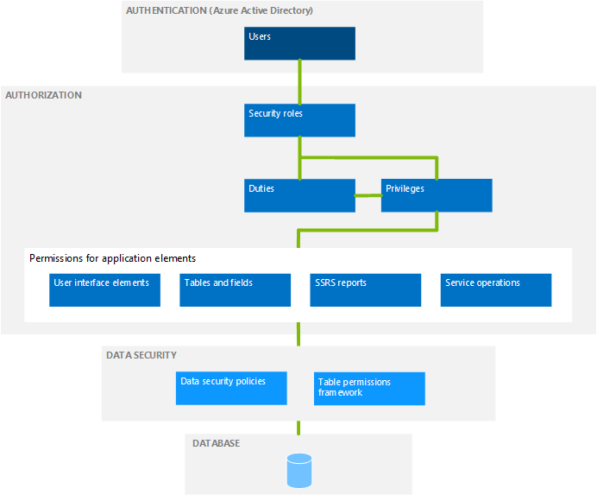
Hierarchy Based Security Model

Slide 13
Security via Configuration (User Interface)

Slide 14
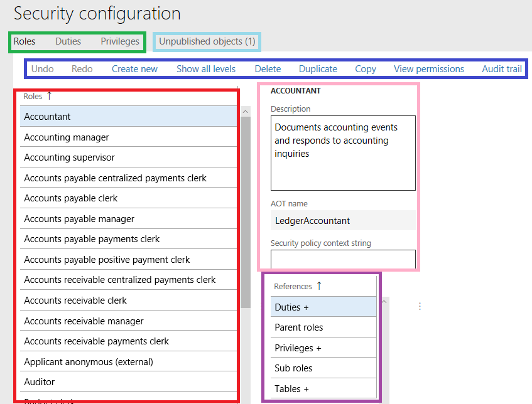
Security Configuration
System Administration ->Security ->Security Configuration
Notes:
Green box – Allows you to switch between roles, duties, and privileges
Blue box – Has a number of different options for performing against the currently selected role/duty/privilege
Undo/Redo – undo/redo customizations applied to this security layer
Create new – create a new security layer
Show all levels – by default D365FO will only show 4 levels of fly-outs in the navigation, this option will force it to show a horizontal scroll bar to fit all fly-out levels
Delete – remove the current security layer
Duplicate – create a clone of the currently selected security layer, allows you to give it a new name
Copy – copies the current security
View Permissions – shows an entire hierarchy of security for the currently selected security layer
Audit Trail – shows the history of all changes made to an object either from user interface or through AOT
Red box – listing of all current objects in selected security layer
Pink box – shows details about currently selected security layer object including Description and AOT name
Purple box – shows all of objects that are either assigned to this security layer or that this security layer is assigned to, the plus icon (+) designates that there are objects already there. So in this case this role has duties, privileges, and tables assigned to it but does not have any sub roles or parent roles.
Light blue – all changes made in the user interface must be ‘published’ before they go live, this object lists all of the changes that are not currently published yet

Slide 15
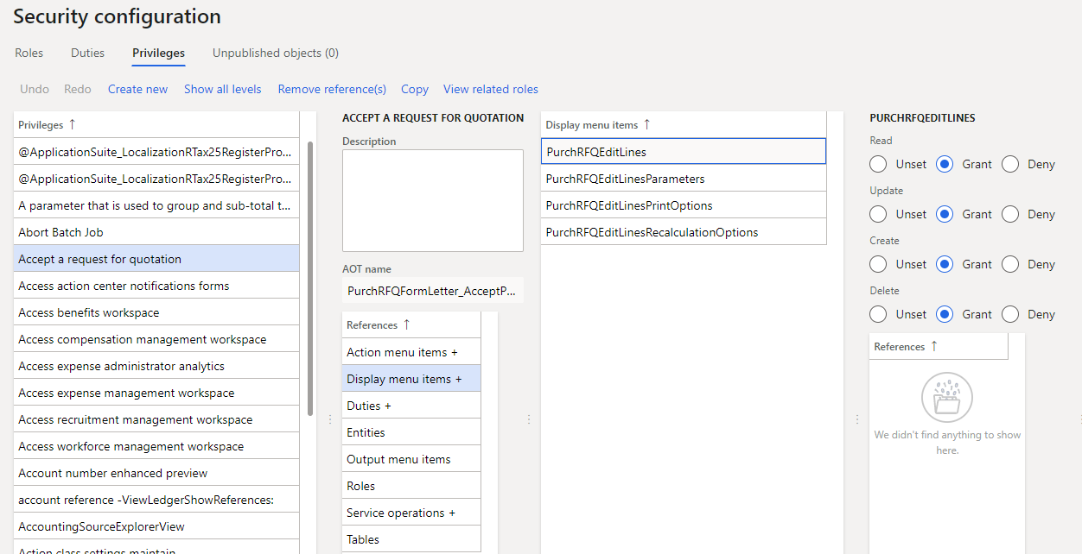
Security Object Access
Object assignment occurs mostly in the privileges area
Find the privilege you would like to modify, select the object type, the finally the object itself to modify its access

Slide 16
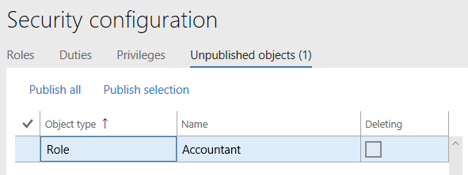
Unpublished Objects
When making a security change, is not immediately active
Goes to an ‘Unpublished Objects’ area for review before publishing

Slide 17
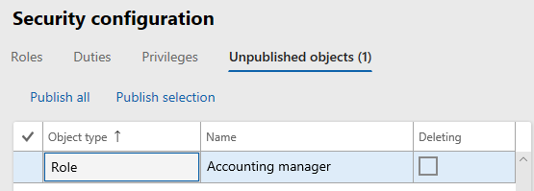
Where are Security Changes Stored?
Security changes made in UI are stored as data in the database
Notes:
If you create/customize a role, duty, or privilege in the UI, a ‘security delta’ is created in database
Roles -> SecurityRoleCustomizeDiskObject
Duties -> SecurityDutyCustomizeDiskObject
Privileges -> SecurityPrivilegeCustomizeDiskObject
Customizations done in the UI are not ‘development artifacts’ (code) in that they do not exist in the design time
- This is a big deal because if you want to move roles between environments (dev/test -> prod) you need your security to be in the design time(code) to be able to create a deployable package to move
- Best advice, is to create all role, duties, and privileges in your design time environment (Visual Studio) so all of your security changes are captured and can be applied to other environments.

Slide 18
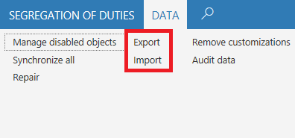
How to Migrate Security Changes?
Security changes can be exported/imported via an XML file
Found in System Administration -> Security Configuration -> Data tab -> Import/Export

Slide 19
Security via Code (AOT)

Slide 20


Slide 21
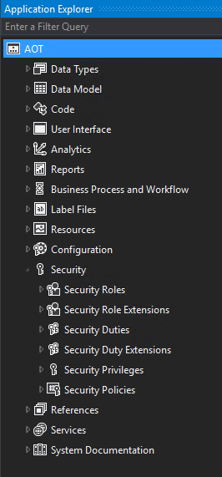
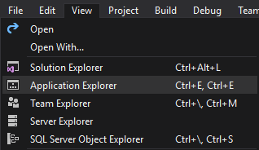
How to Access AOT
Can be found in development environment
by RDP-ing to it (if hosted in Azure) or a local VM
Will have modified version of Visual Studio
Go to View -> Application Explorer

Slide 22
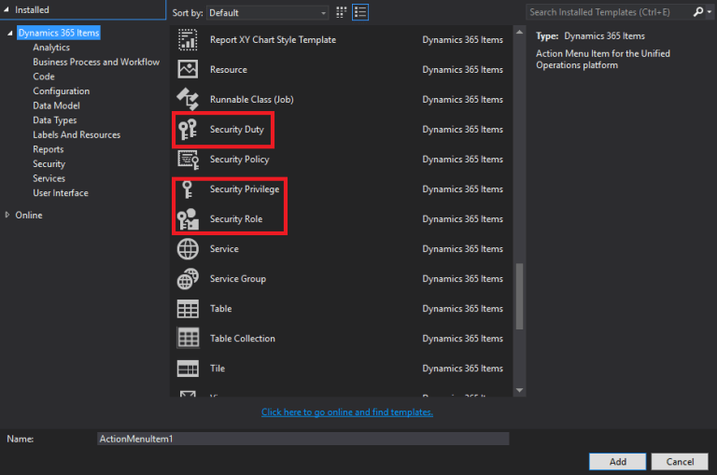
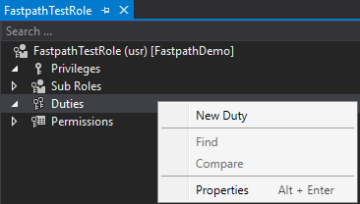
Creating a Security Layer
Creating a role/duty/privilege

Slide 23
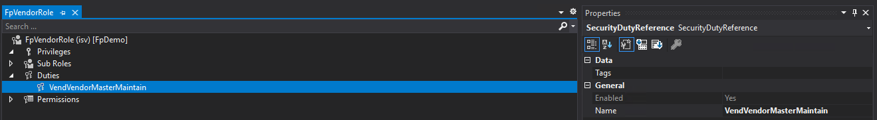
Associating Security Layers
Associating duty -> role

Slide 24
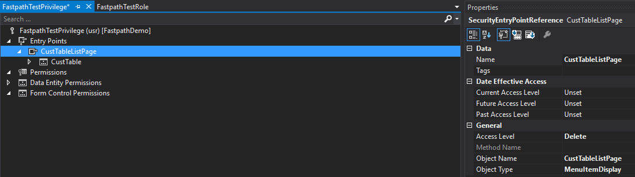
Configuring Object Access
At privilege level, Properties window will change for object access

Slide 25
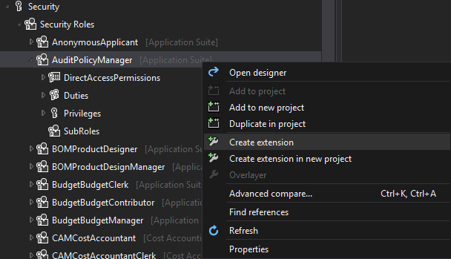
You are unable to directly modify out of box security (overlayering) due to Microsoft’s locking of models
Instead, you must create an ‘extension’

Slide 26
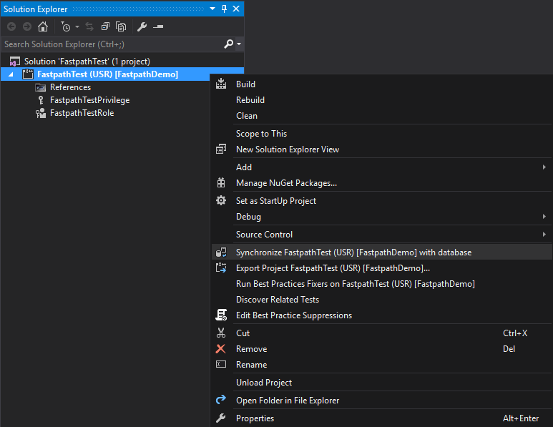
Synchronize Database
Changes made to security in AOT do not go live immediately
You must ‘synchronize’ the changes at the project level

Slide 27
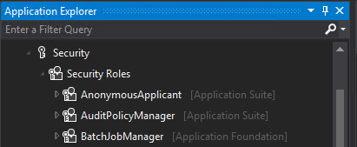
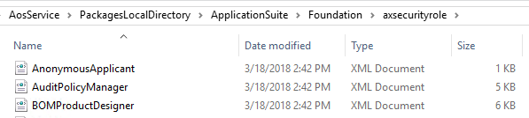
Where Are Security Changes Stored?
Stored as ‘development artifacts’
XML files at project level

Slide 28
Storage Location Based On Development Environment Type
Cloud Hosted Environment (CHE)
K:\AosService\PackagesLocalDirectory\<Model>
Virtual Hard Drive (VHD)
C:\AosService\PackagesLocalDirectory\<Model>
Unified Developer Experience (UDE)
C:\Users\<Users>\AppData\Local\Microsoft\Dynamics365\<version>\PackagesLocalDirectory\<Model>

Slide 29
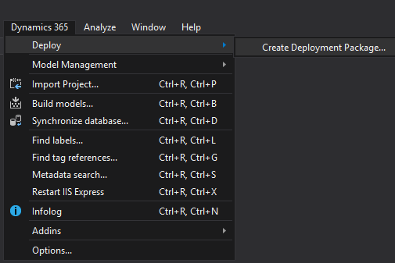
Security Code Build
Best practice is to use ALM model of the build server and code promotion
Since security changes in AOT are code artifacts you can build a deployable package with the changes and move these to another environment

Slide 30
Security Demo

Slide 31
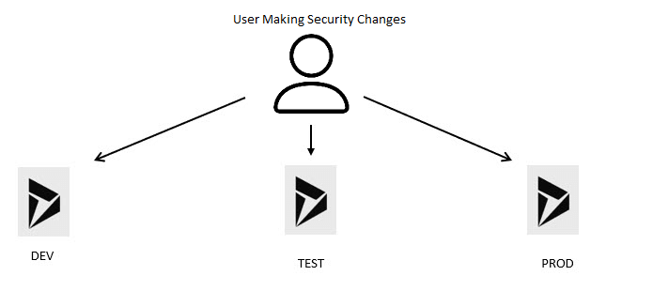
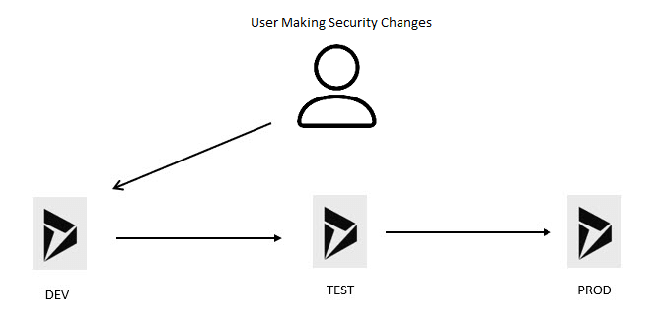
Security Deployment and Maintenance
Follow ALM process
Treat security as code
Don’t deploy security like this…
Instead, follow ALM process

Slide 32
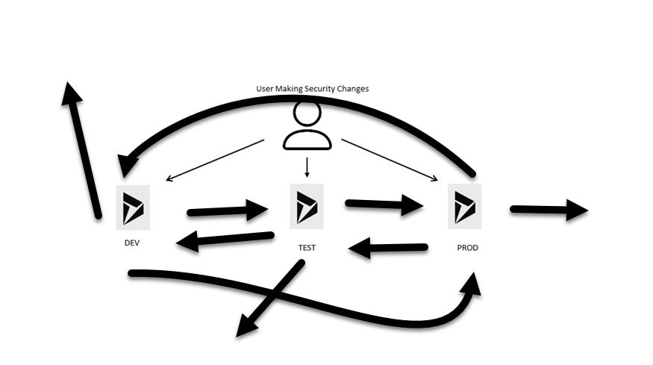

Security Deployment and Maintenance

Slide 33

Automation Can Help
UDEs are here
Can use DevOps to deliver code and security faster
Spin up / Spin down on demand

Slide 34
Microsoft’s Recent Security Announcement
Optimizing ERP Security Configuration and Licensing within Microsoft Dynamics 365 - Microsoft Dynamics 365 Blog
Simplify role management
Ensure compliant role-based access control
Advanced security features
Role Audit Trail
Security versioning and snapshot capabilities
Temporary role assignment
Elevated privilege management (firefighter)
Detailed licensing insights

Slide 35
Resources
Nathan’s Blog
Alex’s D365FO Blog
Three Part Security Setup Series
Setting up Security from User Interface
Setting up Security from AOT
Security Management and Maintenance
D365FO Security Course
D365FO Admin Toolkit

Slide 36
Questions?
Alex Meyer
Email: alex.meyer@delinea.com
Blog: http://d365foblog.com
Security Class: http://d365fosecurity.com
GitHub: https://github.com/ameyer505
LinkedIn | Microsoft MVP Profile
Nathan Clouse
Email: nathan.clouse@armanino.com
Blog #1: https://www.atomicax.com
Blog #2: https://www.dynamics.fo
GitHub: https://github.com/NathanClouseAX
LinkedIn | Microsoft MVP Profile

Slide 38
AX/FINANCE & OPS
© 2024 Dynamic Communities. All rights reserved.

Slide 39
© 2024 Dynamic Communities. All rights reserved.

